Slide 1
Session: Watson Anywhere and Cloud Pak for Data
NDA21T0512B
Session ID = J0552, Check-in code = ae4d
Jennifer Wales
Giulio Soliani

Slide 2
Legal Disclaimer
{Remove after Editing: Sections / text in red need to be customized for each presentation and then removed from the final draft.}
© IBM Corporation 2020. All Rights Reserved.
The information contained in this publication is provided for informational purposes only. While efforts were made to verify the completeness and accuracy of the information contained in this publication, it is provided AS IS without warranty of any kind, express or implied. In addition, this information is based on IBM’s current product plans and strategy, which are subject to change by IBM without notice. IBM shall not be responsible for any damages arising out of the use of, or otherwise related to, this publication or any other materials. Nothing contained in this publication is intended to, nor shall have the effect of, creating any warranties or representations from IBM or its suppliers or licensors, or altering the terms and conditions of the applicable license agreement governing the use of IBM software.
References in this presentation to IBM products, programs, or services do not imply that they will be available in all countries in which IBM operates. Product release dates and/or capabilities referenced in this presentation may change at any time at IBM’s sole discretion based on market opportunities or other factors, and are not intended to be a commitment to future product or feature availability in any way. Nothing contained in these materials is intended to, nor shall have the effect of, stating or implying that any activities undertaken by you will result in any specific sales, revenue growth or other results.
If the text contains performance statistics or references to benchmarks, insert the following language; otherwise delete: Performance is based on measurements and projections using standard IBM benchmarks in a controlled environment. The actual throughput or performance that any user will experience will vary depending upon many factors, including considerations such as the amount of multiprogramming in the user's job stream, the I/O configuration, the storage configuration, and the workload processed. Therefore, no assurance can be given that an individual user will achieve results similar to those stated here.
If the text includes any customer examples, please confirm we have prior written approval from such customer and insert the following language; otherwise delete: All customer examples described are presented as illustrations of how those customers have used IBM products and the results they may have achieved. Actual environmental costs and performance characteristics may vary by customer.
Review text for proper trademark attribution of IBM products. At first use, each product name must be the full name and include appropriate trademark symbols. Subsequent references can drop “IBM” but should include the proper branding (e.g., IBM Bluemix or WebSphere Application Server). Please refer to http://www.ibm.com/legal/copytrade.shtml for guidance on which trademarks require the ® or ™ symbol. Do not use abbreviations for IBM product names in your presentation. All product names must be used as adjectives rather than nouns. Please list all of the trademarks that you use in your presentation
If the text/graphics include screenshots, no actual IBM employee names may be used (even your own), if your screenshots include fictitious company names (e.g., Renovations, Zeta Bank, Acme) please update and insert the following; otherwise delete: All references to [insert fictitious company name] refer to a fictitious company and are used for illustration purposes only.

Slide 3
Session Agenda
Introduction to Session​
Watson on CP4D
Licensing Watson on CP4D
Sizing Watson on CP4D
Sizing Calculator
Additional Resources​
Link to deck: https://ibm.ent.box.com/s/mrshyve6tmhec8t9uxgmrlhj2e2cuanb/file/643758660190

Slide 4


By Applying AI to transform core business domains
Customer
Service
CCO
Risk &
Compliance
CRO
The AI Ladder
Intelligent workflows
Predictive
Automated
Agile
Trusted
Operations
COO
IT
CIO
Planning & Forecasting
CFO
4
Notes:
We all know data is the foundation for businesses to drive smarter decisions. Data is what fuels digital transformation. But, it is Artificial intelligence (AI) that unlocks the value of that data, which is why AI is poised to transform businesses with the potential to add almost 16 trillion dollars to the global economy by 2030.
However, adoption has been slower than anticipated. Business leaders not only need to understand the power of AI, but how they can fully unleash its potential and operate in a hybrid, multicloud world.
This presentation aims to demystify AI, present common AI challenges and failures, and finally, provide a unified, prescriptive approach (which we call “the AI Ladder”) to help organizations unlock the value of their data and accelerate their journey to AI.

Slide 5





IBM AI applications
Used globally by thousands of organizations
Watson
Assistant
Financial
Crime Insights
with Watson
Pre-built, pre-trained and
domain optimized
Intelligent, humanized
interaction (NLP)
Self-learning, intelligently automated AI workflows
Built upon a common
multicloud data & AI platform
Maximo & Sterling Supply Chain
with Watson
Planning
Analytics
with Watson
Business
Transformation
Services
Watson Discovery
for document Search & NLP
Cognos Analytics
for data visualization
Open Pages
for ReqTech
Cloud Pak for Data
Cloud Pak for Automation
IBM Cloud
Notes:
We all know data is the foundation for businesses to drive smarter decisions. Data is what fuels digital transformation. But, it is Artificial intelligence (AI) that unlocks the value of that data, which is why AI is poised to transform businesses with the potential to add almost 16 trillion dollars to the global economy by 2030.
However, adoption has been slower than anticipated. Business leaders not only need to understand the power of AI, but how they can fully unleash its potential and operate in a hybrid, multicloud world.
This presentation aims to demystify AI, present common AI challenges and failures, and finally, provide a unified, prescriptive approach (which we call “the AI Ladder”) to help organizations unlock the value of their data and accelerate their journey to AI.

Slide 6

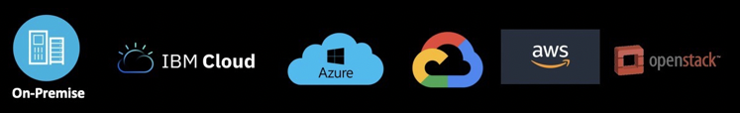
Watson on CP4D Stack
Watson Cartridges
Watson Cartridge Entitlement
CP4D License Entitlement
CP4D Modules
Cloud Pak for Data (CP4D) Control Plane
← Required for all deployments
Infrastructure Services (K8s & Common services)
← K8 app platform Openshift v3.11
← Run Anywhere
Notes:
CP4D includes entitlement for Portworx up to 5TB on 8 Workers (confirm)

Slide 7
Watson pre-built Apps on Cloud Pak for Data
November release
Watson Assistant
Watson Assistant Voice Interaction
Watson Discovery
Includes:
Content Mining
Content Intelligence
Watson Knowledge Studio
Watson API Kit Speech to Text, Text to Speech, NLU, WKS, Language Translator

Slide 8
Pattern | Cartridges | License | Components
Watson Assistant for Customer/Employee Self Service or Agent Assist (Digital) | Watson Assistant | Instance (Prod) MAU (1x 10k users) Instance (Non-Prod) | Watson Assistant
Watson Assistant for Customer/Employee Self Service or Agent Assist (Voice) | Watson Assistant Voice Interaction | WAVI 50 concurrent connections (Prod) minutes (1x 10k minutes) Instance (Non-Prod | Watson Assistant Speech to Text Text to Speech Voice Gateway
Watson Assistant for Customer/Employee Self Service or Agent Assist (Omni channel) | Watson Assistant Voice Interaction (Omni) | WAVI 50 concurrent connections (Prod) minutes (1x 10k minutes) MAU (1x 10k users) Instance (Non-Prod | Watson Assistant Speech to Text Text to Speech Voice Gateway
Watson Assistant AND Watson Discovery for Customer/Employee Self Service or Agent Assist | Watson Assistant Watson Discovery | WA Instance (Prod) WA MAU (1x 10k users) WA Instance (Non-Prod) Base Discovery (40VPC -Prod) Incremental VPC (8) RVU (1x 100K docs) Non Prod Discovery (24 VPC) Non Prod Discovery (8 VPC) | Watson Assistant Watson Discovery
Watson Discovery for Expert Assist | Watson Discovery (Longtail Search or Content Mining) | Base Discovery (40VPC -Prod) Incremental VPC (8) RVU (1x 100K docs) Non Prod Discovery (24 VPC) Non Prod Discovery (8 VPC) | Watson Discovery Watson Knowledge Studio (if used)

Slide 9
Pattern | Cartridges | License | Components
Email Classification, Root Cause Analysis, Language Translation | API Kit (NLU) (Language Translation) | API Kit 32 VPC (Prod) API Kit 32 VPC (Non-Prod) | NLU Language Translation
Voice of the Customer | Watson Discovery | Base Discovery (40VPC -Prod) Incremental VPC (8) RVU (1x 100K docs) Non Prod Discovery (24 VPC) Non Prod Discovery (8 VPC) | Watson Discovery WEX Content analytics Studio Watson Knowledge Studio (if used)
Contract Analysis | Watson Discovery | Base Discovery (40VPC -Prod) Incremental VPC (8) RVU (1x 100K docs) Non Prod Discovery (24 VPC) Non Prod Discovery (8 VPC) | Watson Discovery Watson Knowledge Studio (if used)
Speech Transcription | API Kit (Speech Services) | API Kit 32 VPC (Prod) API Kit 32 VPC (Non-Prod) | STT TTS (if used)
Speech Voice of the Customer | API Kit (Speech Services) (NLU for Sentiment) | API Kit 32 VPC (Prod) API Kit 32 VPC (Non-Prod) | STT NLU

Slide 10
Watson Assistant
and
Watson Assistant Voice Interaction
Updates from November
Committed Term Licenses announced
Clients need to purchase separate entitlements for production and non-production installations
Use Cases
Sell Watson Assistant for digital/web scenarios
Sell Watson Assistant Voice Interaction for voice/phone scenarios
Sells Watson Assistant Voice Interaction with Omni for web and voice scenarios

Slide 11
Watson Assistant
Parts Pricing
Perpetual (List)
CTL (List)
Metric | Comments
Install (Prod)
Monthly Active User | Per 10K Users
Install (Non-Prod) | Per environment
Metric | Comments
Install (Prod)
Monthly Active User | Per 10K Users
Install (Non-Prod) | Per environment
Key Notes:
Production
Customers purchase Install which can run up to 10M users (from a compute perspective).
Customers also have to purchase licensing for each 10K Monthly Active Users.
Non-Production
Customers need to purchase Non-prod Install if they want a separate cluster to run dev and test.

Slide 12
Watson Assistant Voice Interaction
Parts Pricing
Perpetual (List)
CTL (List)
Metric | Comments
50 Concurrent Connections | Min 50 concurrent / Buy in packs of 50
Per 10K Minutes | Buy in packs of 10K minutes
Omni use case: Monthly Active User | Buy in packs of 10K users
Optional: Non-Production 50 concurrent connections | Lower price version coming Q1 2020
Metric | Comments
50 Concurrent Connections | Min 50 concurrent / Buy in packs of 50
Per 10K Minutes | Buy in packs of 10K
Omni use case: Monthly Active User | Buy in packs of 10K users
Optional: Non-Production 50 concurrent connections | Lower price version coming Q1 2020
Key Notes:
Production
Customers need to purchase 50 concurrent connections to start and add concurrent connections in packs of 50 as needed.
Customers must also purchase licensing for each 10K minutes.
If Omni, customers also have to purchase licensing for each 10K Monthly Active Users.
Non-production
Customers need to purchase Non-prod Install if they want a separate cluster to run dev and test.

Slide 13



Watson Discovery
November Release
November Updates
Content Miner now included in Watson Discovery license
Compare and Comply capabilities included as additional (and optional) component
Committed Term Licenses announced
Clients need to purchase entitlements for non-production installations
Watson Discovery
AI-powered search platform for expert assist solutions or for enhancing conversational apps
Content Miner
Content Miner is available with November release of Watson Discovery
Content Intelligence
Access compare and comply functionality by licensing and installing this optional component.

Slide 14
Perpetual (List)
CTL (List)
Watson Discovery
Pricing
Metric | Comments
Base Discovery (40 VPC)
Incremental VPC (pack size = 8) | Requires Base
RVU (VUE164) (1 resource = 100,000 docs) | Minimum Initial Purchase of 1
Content Intelligence (Install) | Content Intelligence (previously C&C)
Optional: 8 VPC Pack (non-prod) | Requires Base
Metric | Comments
Base Discovery (40 VPC)
Incremental VPC (pack size = 8) | Requires Base
RVU (VUE164) (1 resource = 100,000 docs) | Minimum Initial Purchase of 1
Content Intelligence (Install) | Content Intelligence (previously C&C)
Optional: 8 VPC Pack (non-prod) | Requires Base
Key Notes:
Production
Customers must purchase a Base Discovery part to initially access the environment. RVUs need to be purchased for each 100,000 docs ingested.
Additional VPCs in 8 pack increments can be added to include Watson Knowledge Studio or improve performance & throughput.
Content Intelligence requires Base Discovery
Non-Production
Non-prod instance requires 24 VPC. Customer should buy the amount of non-prod VPCs needed for their config

Slide 15


Watson API Kit
November Release
November Updates
Introduce Watson Language Translator capabilities to Watson API Kit
Committed Term Licenses announced
Clients need to purchase entitlements for non-production installations
Natural Language Understanding
Analyze text to extract meaning such as entities, relations, and sentiment.
Watson Knowledge Studio
Teach IBM Watson the language of your domain with custom models
New! Watson Language Translator
Translate text from one language to another. Customize as needed.
Watson Speech to Text
Provides advanced speech transcription capabilities.
Watson Text to Speech
Understands natural language text to generate synthesized audio output.

Slide 16
Watson API Kit
Pricing
Perpetual (List)
CTL (List)
Metric | Comments
Base API Kit (32 VPC)
Incremental VPC (pack size = 8) | Requires Base
Optional: 32 VPC Pack (non-prod) | Requires Base
Metric | Comments
Base API Kit (32 VPC)
Incremental VPC (pack size = 8) | Requires Base
Optional: 32 VPC Pack (non-prod) | Requires Base
Key Notes:
Production
Customers must purchase a Base API Kit part to initially access capabilities. Base part gives clients access to 32 VPCs of CP4D & RH OS licenses
Additional VPCs in 8 pack increments can be added to improve performance.
Non-Production
Customers must purchase 32 VPC non-prod base part. Add VPCs in 8 pack increments.
VPCs for non-prod vary based on what component is installed

Slide 17
Watson API Kit
VPCs for API Kit
Key Notes:
Each component within API Kit has a different workload (VPCs), but the license is calculated:
Base (32) + Incremental (8x) = number of VPCs needed to run and need licensing
Always need the Base
 | Min VPCs | Min VPC Capability | Increment Capability
NLU | 22 | 20,124,00 items per month (w/ customization) | Additional 7.8m items per month
WKS | 10 | 2 users and 20GB of storage | 10 users and 100GB of storage
STT | 22 | 12 concurrent sessions and 520k minutes per month | Additional 12 concurrent sessions and 240k minutes per month
TTS | 10 | 10 concurrent sessions and 162m characters per month | Additional 324 million characters per month and 20 concurrent sessions
LT | 10 | 3.5B characters per month | Additional 3B characters per months

Slide 18
Planning for Watson on CP4D
Use Case / Pattern
Inputs
Use Case
Technologies – Cloud Pak for Data, Cloud Pak for Data Optional Modules and Cartridges
Platform – VM – Bare metal – CP4D System – Public Cloud(s)
Availability Requirements – With or without redundancy
Number of Environments Needed – Dev / Test / Prod
Outputs
Hardware – Compute needed for OpenShift + CP4D + Watson
Software – Licenses needed
Services
Technologies
Platform
Availability
Hardware
Software
Watson on CP4d Sizing & Pricing: https://w3.ibm.com/w3publisher/watson-cp4d
Sizing Watson on CP4D Survey: Link
Notes:
Use Case – AI For RegTech, AI For Customer Svc, Trusted AI, Automate AI, AI for Fast Data, Governed Data Ops
Technologies – Core CP4d Module(s), Cartridges: Assistant – Discovery – WKS – NLU – Speech – Language Svc
Platform – VM – Bare metal – AWS – Azure – CP4D System – Managed OpenShift
Availability – Development or Highly Available
Compute is the physical infrastructure you will need to run your workload. How many virtual machines, and for each machine, how many processors, memory and disk will be needed?

Slide 19
Sizing Watson Solutions
Licenses and Compute over the life of a deal will evolve
Pre-Sales
Proposed use case
Functional /non-functional requirements not defined
Licensing Estimate
Rough Order of Magnitude Estimate of Hardware to support planned use case (ROM Compute)
**Does not take into consideration planned load**
Post Sales / Pre-Implementation
Targeted use case
Estimate of load
Known requirements for # of documents, enrichments, api calls, languages
Requirements for availability
Requirements for Non-Prod environment(s)
Custom Compute
Validate Licensing will support deployment
Notes:
Sales / Tech sales needs the ability to provide sizing estimates based on lifecycle of the deal. Will need ability to refine estimates when requirements or budget changes
Some Watson licensing driven by non functional requirements that may not be known yet so licenses are really estimates until deployment
Requirements that are needed to size precise estimate for compute typically are not known during presales. Need a way to provide estimate of compute to progress deals

Slide 20
Sizing Example – Employee Facing AI Assistant POC
ABC Chemical Corporation is looking to make it easier for their employees (engineers mostly) to find information about Chemical products. The content is company proprietary and very domain specific. They want to start an on premise POC to evaluate how Watson technology can help their engineers find the answers they need without spending too much time searching through the database of product reports.
At the last meeting, they mentioned they expect 500 engineer using the system on a daily basis and for the first POC they want to test Watson on 10,000 engineering documents (less than 1GB of content).

Slide 21
Watson on CP4D Technical Requirements
Platform
Bare Metal, VM, IBM Cloud, AWS, Azure
Hardware
x86 platform / Intel architecture nodes only
CPUs must have 2.4 GHz or higher clock speed & must support Linux SSE 4.2 and AVX2 instructions
Cloud Pak for Data
CP4D 2.5 on OpenShift 3.11 (Q4 2019)
CP4D System 1.0.4 (with Portworx)
Storage
Watson Services require Portworx Storage & CRI-O Container Runtime
AWS Quickstart & Managed OpenShift in IBM Cloud not yet certified for Watson
Notes:
For our on premise example we can deploy to VM or bare metal, but we can support deployments to all of the major public clouds: AWS, Azure & Google. Managed openshift not yet certified for Watson. The best luck we have had was with Managed Openshift, SDS nodes, and Portworx enterprise. We hope to support it in Q2. WAVI does not support System.
Watson requires CP4D. We currently support one release back which includes support for ICP, as of next release we will support Openshift exclusively
No support for any other Kube versions
Support is specific to the release. Releases change every 3 months
Portworx is the preferred storage manager providing enterprise class storage on Kubernetes & RH Openshift. IBM has a Resell agreement now in place (not an OEM) that provides a $0 tier for customers to use Portworx for free, with up to 5TB per volume, 8 storage nodes maximum.

Slide 22
Estimating Licensing
Overview of Process
Go to Licensing Calculator in Seismic: https://ibm.seismic.com/Link/Content/DCmPHmkSb-Xk6P-gWUfCQctA
Input: Add desired options to Sizing Inputs Sheet
Step 1. Select Watson Bundle - Watson Assistant & Watson Discovery for our example WBS POC
Step 2 Select if Non-Prod Licenses are needed and if they will be used in separate cluster -Non-Prod not needed for our POC
Step 3. For each Bundle, input options, metric(s): Users, Documents, Connections, etc,
Watson Assistant – default 10,000 users
Watson Discovery – default 100,000 docs, Content Intelligence not needed, Knowledge Studio will be needed for domain training
WBS Assets will be needed
Output: Review Output on Licensing Sheet - (Committed Term and Perpetual Options)

Slide 23
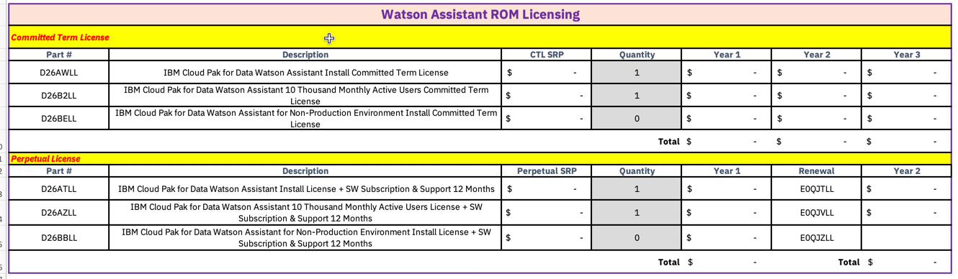
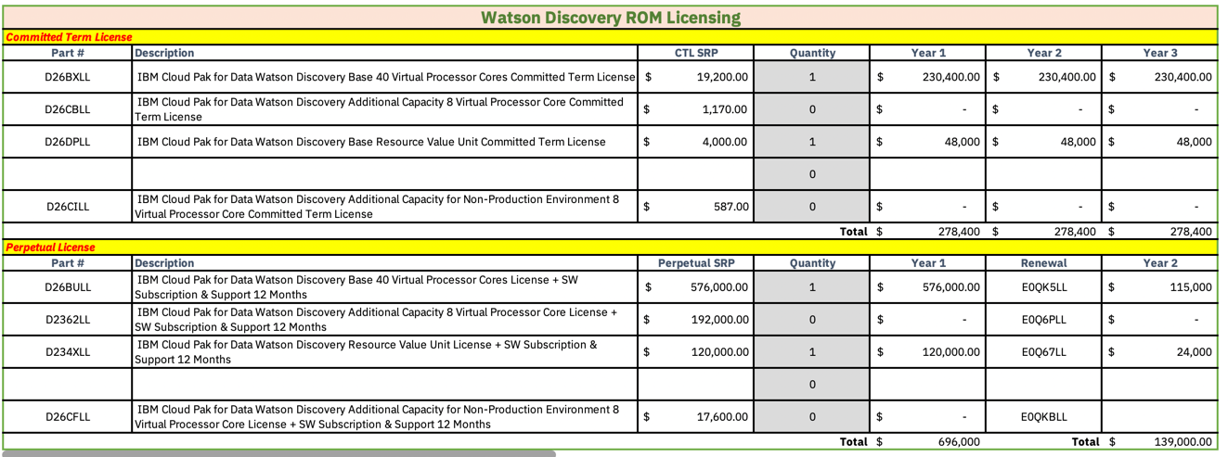
Licensing Results – Example WBS POC
Notes:
Watson license includes license for CP4D limited use.
CP4D includes entitlement for Portworx up to 5TB on 8 Workers
No licensing required for the wbs, this will come into play for our compute.
To use any cp4d optional modules, you would require a full cp4d license

Slide 24

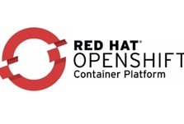
CP4D 2.5 OpenShift Cluster
Users
Management functions for OpenShift Cluster
Load balancer
This is where workload runs.
Master/Infra Nodes
Application Nodes
(Workers)
Master Nodes
Infra Nodes
Worker1
Worker3
Worker1
Worker2
Worker3
Master Nodes
Master Nodes
Worker2
Master Nodes
Master Nodes
Docker and
Local
Local-storage
ETCD
Storage
Registry
Storage
Docker and
Local
Local-storage
App Storage
NFS Storage
Portworx Storage

Slide 25
Estimating Compute
Estimating compute is primarily about estimating the number of application nodes needed to support the planned workload.
Planned workload = Cloud Pak for Data Control Plane + Optional Module(s) + Cartridge(s) (Watson Services)
Planned workload may include other Application code needed for the solution, like Portworx (to manage Watson shared storage) or Application Code (WBS Assets)
To size the planned workload – you need to know the following for each component
Cores- how much processing power needed (in Cores or VPCs)
Memory - how much memory needed (in GB)
Storage - how much storage and what type of storage is needed (Watson uses Portworx, but some CP4D modules use NFS)
Worker nodes - minimum and recommended number of worker nodes. In addition to calculating overall compute needs, this is an additional requirement for some services (like WA and WDS) that require a specific amount of worker nodes as part of their HA story.
Notes:
Estimating compute is primarily about estimating the number of application nodes needed to support the planned workload.
The management infrastructure for the most part is not as variable (Masters / Infra / Storage)
The workload will change depending on the deploy type (dev or ha).

Slide 26
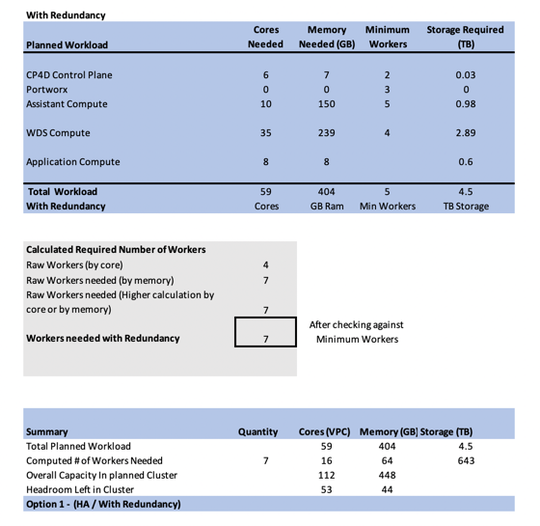
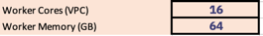
Formula for calculating # of Worker Nodes
1) Sum the Watson workloads + CP4D Control plane
2) Input: Desired worker node configuration (or take defaults)
3) Calculate the raw # of worker nodes needed
Workload Cores ÷ Worker Cores. 59÷16=3.7 Workers
Workload Memory ÷ Worker Memory 404÷64=6.37 Workers
Take the higher of the calculations Memory calculation
Compare against service minimum and adjust if needed
4) Calculate Total Storage required by adding storage for each service & rounding to nearest TB → this will be total Portworx storage required within the cluster.
5) Calculate Portworx storage needed per worker
Raw Disk = Total Storage ÷ Workers needed.
4.5 ÷ 7 Workers = .643 TB or 643 GB per worker
Notes:
To estimate the worker nodes, we add up the compute required for each of the individual components + make sure we allow for some amount of overhead (10-15%). This gives us the required compute needed to run the planned workload. Once we know how much compute is required, we can lay out the worker node configuration that will most closely meet this requirement without too much overhead.
To size the total workload - you have to know the requirements of each component
Cores- how much processing power needed (in Cores or VPCs)
Memory - how much memory needed (in GB)
Storage - how much storage and what type of storage is needed
Worker nodes - minimum and recommended number of worker nodes. In addition to calculating overall compute needs, this is an additional requirement for some services (like WA and WDS) that require a specific amount of worker nodes as part of their HA story.

Slide 27
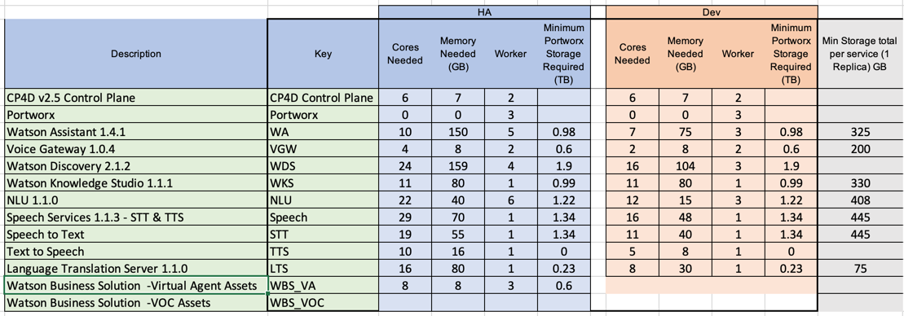
Where do the Workload estimates come from?
ROM vs Detailed
Minimum requirements (ROM) for each component available in the release notes for each component in two flavors: HA (with redundancy) or Development (without redundancy)
Minimum requirements do not take into consideration the planned usage, thus should not be used for production grade estimates but are appropriate for an idea of the footprint needed for budgetary purposes
For more detailed calculations, we rely on development provided service calculators (Assistant, Discovery, Speech)
Detailed calculators will require information about the planned usage, customizations, languages, etc
Workload estimates are specific to each version / release
Portworx storage assumes 3 replicas
Watson Workload Minimums Current release(s)
Notes:
ROM compute does not take into consideration load – for that we must use detailed calculators
ROM estimates not suitable for prod estimates
ROM Compute provides 2 options – with redundancy and no redundancy. The calculations are the same, however the cores needed for each workload will be less

Slide 28
Estimating ROM Compute – Using Licensing Calculator
Overview of Process
Go to Licensing Calculator <add link>
Input: Add desired options to Sizing Inputs Sheet
Step 1. Select Watson Bundle - Watson Assistant & Watson Discovery for our example WBS POC
Step 2 Select if Non-Prod Licenses are needed and if they will be used in separate cluster -Non-Prod not needed for our POC
Step 3. For each Bundle, input options, metric(s): Users, Documents, Connections, etc,
Watson Assistant – default 10,000 users
Watson Discovery – default 100,000 docs, Content Intelligence not needed, Knowledge Studio will be needed for domain training
WBS Assets will be needed
Output: Review Output on ROM Compute Sheet. Two options are output with Redundancy & Minimal Compute
Notes:
Same basic process as licensing process, with ROM compute output to a separate sheet

Slide 29
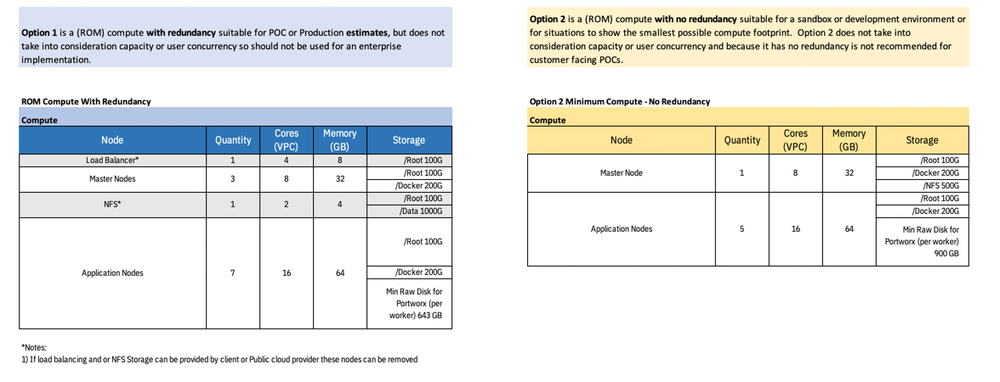
ROM Compute Results –Example WBS POC
Option 1 – With Redundancy – suitable for POC, Pilot or Production Estimate
Option 2 – No Redundancy - suitable for sandbox or development environment
**ROM Compute can be used to size only 1 cluster at a time
Notes:
ROM Compute does the math for you. Displays two options – with and without redundancy and gives you the option to modify estimate based on what the customer may have (size of worker nodes may be smaller for public cloud for example.
Estimate includes everything you need to load the service – # of worker nodes for planned workload + starter management infrastructure. LB / Master / Infra nodes, NFS for registry, etc
Starter management infra may not be suitable for all customers, but is a good starting point
Option 2 – No Redundancy - suitable for sandbox or development environment or for situations when you want to show the smallest possible compute footprint,
Option 1 – With Redundancy – preferred estimate and suitable for everything else including POC, Pilot or Production Estimate
Make sure to double check the selected options. What you select on sizing sheet will be estimated for compute. If you select WA and WAVI you will have double the compute.

Slide 30
License & Compute - Example WBS POC
Node | Quantity | CPU (VPC) | Memory (GB) | Disk storage(GB)
Load Balancer* | 1 | 4 | 8 | /Root 100G
Master Nodes | 3 | 16 | 64 | /Root 100G /Docker: 200G
NFS* | 1 | 2 | 4 | /Root 100G /Data: 200G
Application Nodes | 7 | 16 | 64 | //Root 100G /Docker: 200G Minimum Raw Disk for Portworx 643GB
Load balancer
Master/Infra Nodes
Application Nodes
(Workers)
Master Nodes
Infra Nodes
Worker1
Worker3
Worker1
Worker2
Worker3
Master Nodes
Master Nodes
Worker2
Master Nodes
Master Nodes
License | Quantity
IBM Cloud Pak for Data Watson Assistant Install License | 1
IBM Cloud Pak for Data Watson Assistant 10 Thousand Monthly Active Users License | 1
IBM Cloud Pak for Data Watson Discovery Base 40 Virtual Processor Cores License | 1
IBM Cloud Pak for Data Watson Discovery Additional Capacity 8 Virtual Processor Core Committed Term License | 0
IBM Cloud Pak for Data Watson Discovery Base Resource Value Unit License | 1
Docker and
Local
Local-storage
ETCD
Storage
Registry
Storage
Docker and
Local
Local-storage
App Storage
NFS Storage
Portworx Storage
Licenses & Compute for Customer facing Virtual Agent POC using WBS Assets
Notes:
Putting it all together – for our POC, we’ll plan to use Committed Term Licenses and the Compute with Redundancy
Be careful of using a dev deploy for a poc, may not present the platform in the best light if it has to take an outage and has no redundancy

Slide 31
Advanced Configurations
Production grade deployments
OpenShift with dedicated nodes: Infra, Storage
Non Production Environments (Dev / Test / Prod)
Notes:
Advanced configurations should be done by tech sales only
Typically later in the sales cycle when non functional requirements are known
Calculator can help with some scenarios, but proceed with caution – garbage in – garbage out.

Slide 32
Non-Production Environments
Different options available depending on Customer’s requirements and budget
Use multi-tenancy capabilities of Watson Service (Same Cluster)
Install CP4D and Watson Service(s) in separate projects / namespaces (Same Cluster)
Install separate OpenShift clusters, each with CP4D and Watson Service(s)
Multi-Tenant Watson
Multi-Tenant CP4D
Separate Cluster
One OpenShift Cluster
One CP4D install
One Watson install
Provision separate instances for Dev / test / prod / etc.
Each instance* can be configured with different access control
No additional licenses needed
Supports single version of Watson Service
*WD does not support multi-tenancy
One OpenShift Cluster
Provision separate projects for Dev / test / prod / etc.
Each project / namespace has CP4D + Watson Service
Each project can be configured with different access control and can run different versions of cp4d / Watson
Additional compute and Non-prod licenses required for Watson Services
Provision separate OpenShift Clusters for Dev / test / prod
Each cluster with CP4D and Watson Service(s)
Each cluster can be configured with different access control and can run different versions of Openshift / cp4d or Watson
Notes:
Multi-tenant Watson Dependent on capabilities of service. WD does not support this option
Watson Assistant & Speech support multi-tenancy
WA supports up to 30 instances, each with up to 50 skills each with one helm install (1 license / minimal additional compute)
Watson Discovery does not support multi-tenancy with one install. Customers are limited to separate collections for dev / test / prod. Since same installation, all users would have same access control capabilities
Multi-tenant cpd
Additional Compute required (worker nodes only)
Management of 1 infrastructure
Requires Prod and Non Prod licenses for Watson Services
Flexibility for testing / upgrading
Separate env
Compute cost x3
Management of 3 different infrastructures
3x Licenses (Prod + (2) non-prod for all services
Allows most flexibility for testing / upgrading

Slide 33
Custom Watson Development Calculators
Inputs are unique to the service
Outputs Workload for the Watson Service: Cores, Memory, & Storage
Watson Assistant
Estimated number of API calls per month (default supports up to 1M)
Estimated Monthly unique Users
Estimated Max Concurrent Users (Users accessing system at one time)
How many simultaneous model training should the system support (resource intensive; prod should not need more than a few)
HA Needed?
Language(s)
Speech to Text
# minutes of audio per month (millions)*
Max Concurrent Speech to Text Sessions
HA Needed?
Which STT language models needed? [Broadband, Narrowband, Shortform NarrowBand]
Language(s) [EN, JA, KO, ZH, FR, AR, DE, PT-BR, ES]
Is Language Customization needed?
Is Acoustic Customization needed?
Is this a live use case? (for example, virtual assistant, close captioning, etc)
Text to Speech
How many characters per month (millions)*
What is max concurrent tts sessions
Is HA needed?
Is Voice customization needed?
Which TTS Voices are needed?
English - US Michael, Allison, Lisa
English -GB - Kate
Japanese - Emi
French - Renee
German - Birgit, Dieter
Portuguese - Isabela
Italian - Francesca
Spanish - LA - Sofia
Spanish - US - Sofia
Spanish - ES Laura or Enrique
Watson Discovery Service
HA Needed?
Size of source data (GB)
Percentage of data daily updated (0 to 100)
Percentage of rich text files (1 to 100)
Percentage of text data in rich text files (1 to 100)
Duration for initial Indexing (hours)
Duration for daily update indexing (hours)
Number of concurrent search requests
Are search and index performed concurrently
Use SDU
Which Enrichments are needed?
Notes:
Updated dev calculator from wd team for 2.1.2 coming. Wavi coming soon.

Slide 34
Custom Sizing Example
Requirements:
Watson Assistant Voice Interaction Use case with SMS
Omni Channel
75 concurrent WAVI users
11k minutes
http://ibm.biz/watson-cp4d-calculator for IBM sales
Notes:
Bps – we have a version for you – can find by searching for Watson on Cloud Pak for Data calculator on ibm.seismic.com

Slide 35
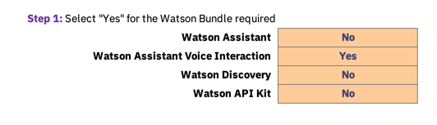
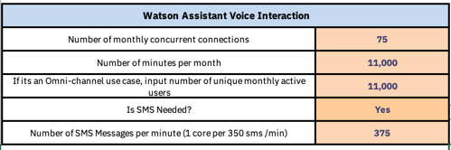
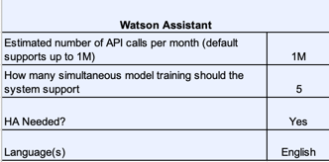
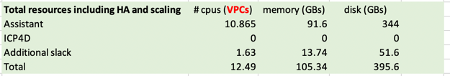
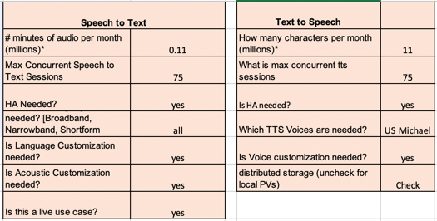
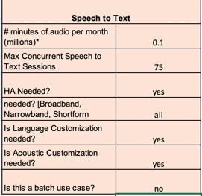
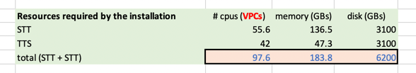
Estimating Custom Compute –Example WAVI
Step 1 – Select Watson Bundle & Options on Sizing Sheet
Step 2 - Go to WA 1.4 Custom Calc Sheet & Input requirements for use case
Step 3 – Go to Speech 1.1 Custom Calc Sheet & Input requirements for use case
Notes:
Do not select both WA and WAVI
Deselect WBS

Slide 36
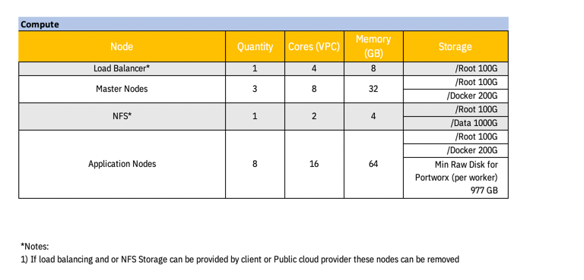
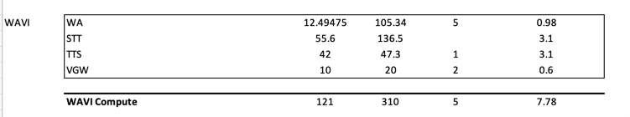
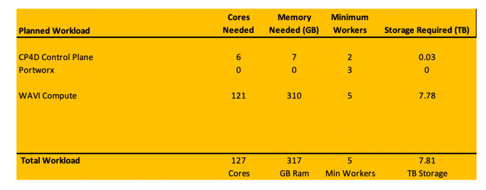
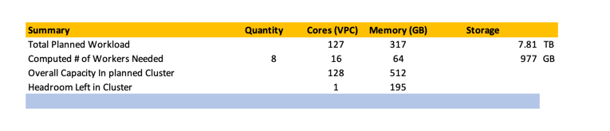
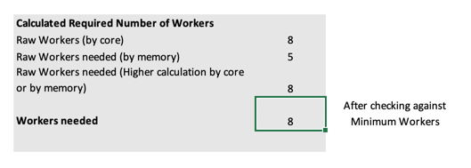
Custom Compute Results – WAVI Example
Custom Compute can be used to size only 1 cluster at a time
Notes:
Custom Compute performs same math as rom compute, but takes input for WA, Speech to Text, TTS, WD from the custom calculators.
As with ROM Compute, Make sure to double check the selected options.

Slide 37
Custom Watson & Data Science Use Cases
Use Sales Configurator Staging Calculator → https://daitoolsdev1.fyre.ibm.com/sales/#/zen/home
Calculator will output cores only
Cores * 4 provides a good estimate of Memory required
Storage will require careful planning as not all Data Science modules can use Portworx Storage

Slide 38
References
Licensing Calculator: http://ibm.biz/watson-cp4d-calculator
DAELL CP4D Practice Wiki: www.ibm.biz/watsoncp4d
Use Sales Configurator Staging Calculator:https://daitoolsdev1.fyre.ibm.com/sales/#/zen/home
Watson Assistant - Slack: #wdc-assistant-help
Watson Assistant with Voice Interaction – Slack #watson-wavi
Watson Discovery - Slack: #wd-cp4d-technical
Watson Knowledge Studio: https://w3-connections.ibm.com/forums/html/forum?id=5f43a252-c824-4741-9598-3b45067f0701&ps=25
NLU Support – Slack: #nlu-icp
Speech Support – Slack: #speech-icp
Language Translation Support – Slack # wdc-language-translat

Slide 39
Please give us your feedback – Access the survey link at the bottom of the
session details in the mobile app.
Giulio Soliani
GTM Offering Manager
gsolian@us.ibm.com
Jennifer Wales
Offering Manager, Data and AI Expert Labs
jennifer_wales@us.ibm.com

Slide 40
Backup Slides

Slide 41





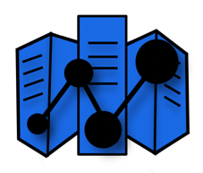


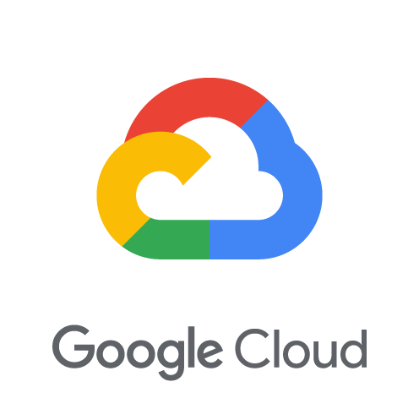


Cloud Pak for Data and Watson Anywhere
An open and extensible cloud-native platform providing a unified set of data and AI services
IBM Watson
Watson Studio
Watson Machine Learning
Watson Knowledge Catalog
Watson APIs
Watson OpenScale
Watson Assistant & Discovery
Eliminate data silos, connect all data
Automate and govern the data & AI lifecycle
Operationalize AI with trust & transparency
Avoid lock-in, run anywhere with agility
One Platform, Any Cloud
INFUSE – Operationalize AI throughout the business
AI
IBM Cloud
ANALYZE – Build and scale AI with trust & explainability
Hyperconverged
Private Cloud Systems
ORGANIZE – Create a business-ready analytics foundation
COLLECT – Make data simple and accessible
MODERNIZE
data for an AI and hybrid cloud world
IBM Cloud / July 2019 / © 2019 IBM Corporation
Notes:
This is our prescriptive approach to helping clients accelerate their journey to AI which connects their data and AI capabilities within a unified data and AI lifecycle (or platform). This is also a way to help our clients identify where they are and where to focus based upon their maturity on the journey to AI. Furthermore, it is an organizing construct to the Data and AI products and services offered by IBM and our business partners, and it is the technology foundation to unify how those products and services work together.
What we have learned from AI pioneers is that every step of the ladder is critical. AI is not magic and requires a thoughtful and well-architected approach. For example, the vast majority of AI failures are due to data preparation and organization, not the AI models themselves. Success with AI models is dependent on achieving success first with how you COLLECT and ORGANIZE data.
Therefore, we believe clients must:
COLLECT -- Establish a strong foundation of data, making it simple and accessible, regardless where that data resides. Since data used in AI is often very dynamic and fluid with ever-expanding sources, virtualizing how data is collected is critical for clients.
ORGANIZE – Create a trusted, business-ready analytics foundation that ensures your data is ready for AI. Just because you can access your data doesn’t mean that it’s prepared for AI use cases. Bad data is paralyzing to AI. So clients must integrate, cleanse, catalog, and govern the full lifecycle of their AI data.
ANALYZE – Once your data is accessible and AI-ready, then you are better prepared to apply advanced analytics and AI models. This rung provides the business and planning analytics capabilities that are key for success with AI. It also provides the capabilities needed to build, deploy, and manage AI models within an integrated portfolio of technology.
INFUSE – Many businesses create highly useful AI models but then encounter challenges in operationalizing them to attain broader business value. This rung of the ladder infuses AI to achieve trust and transparency in model-recommended decisions, decision explainability, bias detection, decision audits, etc. For clients with common use cases, the INFUSE rung operationalizes those AI use cases with pre-built application services, speeding time to value.
MODERNIZE – Given the dynamic nature of AI, your data estate needs a highly elastic and extensible multi-cloud infrastructure to unify the aforementioned capabilities within a fully governed team-platform. Clients are also looking to automate their AI lifecycles across an array of contributors through collaborative workflows. Essentially, MODERNIZE means building an information architecture for AI that provides choice and flexibility across your enterprise. As clients modernize their data estates for an AI and multicloud world, they will find that there is less "assembly required" in expanding the impact of AI across the organization.
----
In Q1 IBM announced a new chapter in the journey from AI experimentation to wide-scale deployment and industry transformation. With the IBM Watson Anywhere announcement, IBM made Watson portable across any cloud and empowered businesses to prevent vendor lock-in and start deploying AI wherever their data resides.
IBM’s value proposition is simply this: Businesses have largely been limited to experimenting with AI in siloes due to the limitations caused by cloud provider lock-in of their data. And with most large organizations storing data across hybrid cloud environments, they need the freedom and choice to apply AI to their data wherever it is stored. By breaking open that siloed infrastructure we can help businesses accelerate their transformation through AI.
And IBM Watson products like Watson Assistant, Watson Open Scale and Watson Discovery are designed to help organizations put AI to work to improve the performance of business.
The Watson Anywhere announcement advanced this mission by providing businesses with a simpler, faster way to build, deploy and run AI models and applications across any cloud. This is accomplished through the Watson product’s integration with IBM Cloud Private for Data. The Watson products like Watson Assistant, Watson Discovery and Watson Open Scale can now be run any environment – on premises, or on any private, public or hybrid-multicloud – enabling businesses to apply AI to data wherever it is hosted.
Remember - IBM Cloud Private for Data is one unified data and AI platform that allows clients to:
Have one integrated console for collecting, organizing and analyzing your data
Virtualize your data regardless of where it lives
Build once and run anywhere across dynamically changing environments
ICP4D supports all of the rungs on the Ladder to AI.

Slide 42
Cloud Pak for Data v2.5
Cartridges
Db2
DataStage
Watson Studio Premium
Cognos Analytics
Watson Assistant
Watson Discovery
Watson API Kit
Watson Financial Crimes Insights
Cloud Pak for Data Enterprise Edition
Optional Modules
Watson Studio (includes Data Refinery)
Watson Knowledge Catalog (Including IGC)
Cognos Dashboards Embedded
Watson Machine Learning (Including AutoAI)
Analytics Engine for Apache Spark
Open source governance
IBM Performance Server (CPD System only)
Db2 Warehouse
Data Virtualization
Db2 Eventstore
IBM Streams
IBM Regulatory Accelerator
Information Analyzer
Watson OpenScale
Control Plane
Zen Shell
User Management
Roles & Privileges
Add-on service mgmt.
Kubernetes Platform - OpenShift
Logging
Monitoring
Metering
Persistent volume /Storage
Kubernetes,
Security
Identity Access Mgmt.
Docker registry/Helm chart mgmt.

